Slide 1
SC-200T00A Microsoft Security Operations Analyst
Author name Date

Slide 2
Module 1: Mitigate threats using Microsoft 365 Defender

Slide 3
Module agenda
Introduction to threat protection with Microsoft 365
Protect your identities with Azure AD Identity Protection
Mitigate incidents using Microsoft 365 Defender
Microsoft Cloud App Security
Remediate risks with Microsoft Defender for Office 365
Respond to data loss prevention alerts using Microsoft 365
Microsoft Defender for Identity
Manage insider risk in Microsoft 365

Slide 4
Lesson 1: Introduction to threat protection with Microsoft 365

Slide 5
Lesson introduction
After this lesson, you will be able to:
Define security threats
Describe common threats
Explain how the threat landscape is evolving

Slide 6
Introduction to threat protection
Endpoint
Email
Apps
Identity
Secrets

Slide 7
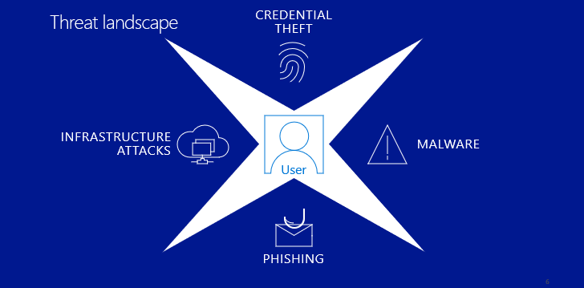
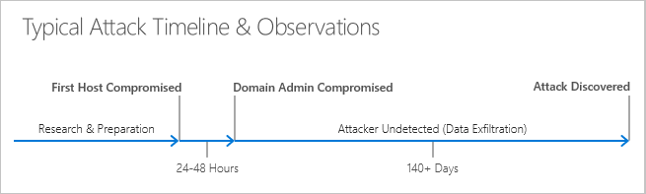
Common threats

Slide 8
Guided demonstration – Microsoft 365 Defender
Scenario:
You are the security operations analyst and must protect organization from harmful activities.
Task 1
Detect security risks
Task 2
Investigate attacks
Task 3
Prevent harmful activities
Notes:
This recorded demo is provided to give learners a sense of Microsoft 365 Defender.
Follow the annotations and advice for where to click.
Time required: 19 minutes
Guided demo link: https://aka.ms/M365Defender-InteractiveGuide

Slide 9
Lesson 2: Mitigate incidents using Microsoft 365 Defender

Slide 10
Lesson introduction
After this lesson, you will be able to:
Manage incidents in Microsoft 365 Defender
Investigate incidents in Microsoft 365 Defender
Conduct advanced hunting in Microsoft 365 Defender

Slide 11
Use the Microsoft 365 Defender portal
The Microsoft 365 Defender portal (https://security.microsoft.com/) is a specialized workspace designed to meet the needs of security teams.
Incidents
Endpoints
Alerts
Email & Collaboration
Hunting
Reports
Action Center
Settings
Secure Score
Permissions

Slide 12
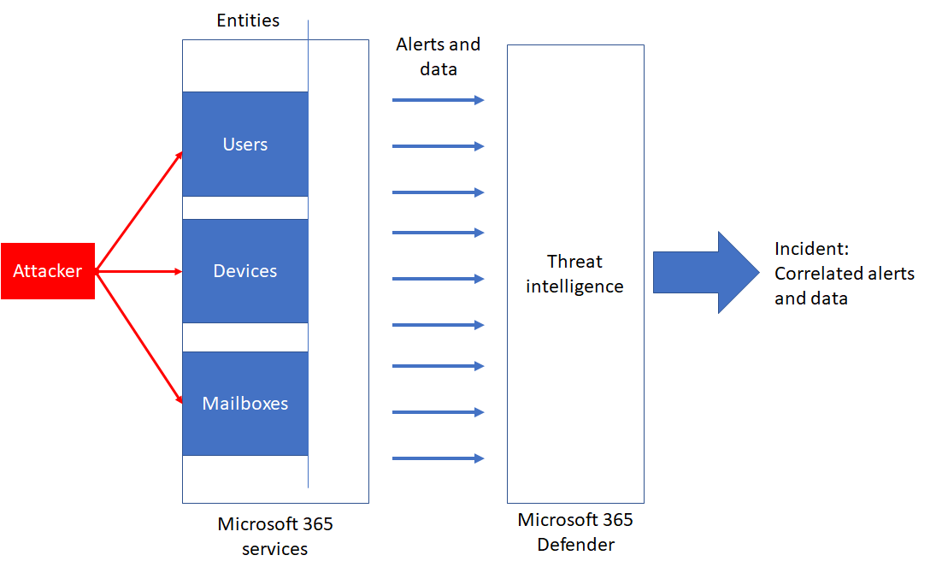
Manage incidents
An incident in Microsoft 365 Defender is a collection of correlated alerts and associated data that make up the story of an attack.
Notes:
Supporting videos for instructor or student use:
Microsoft Threat Protection – Incident management
https://www.microsoft.com/en-us/videoplayer/embed/RE4Bzwz?
(4 minutes)
You can use the Attack simulators to generate Incidents for demonstration purposes.

Slide 13
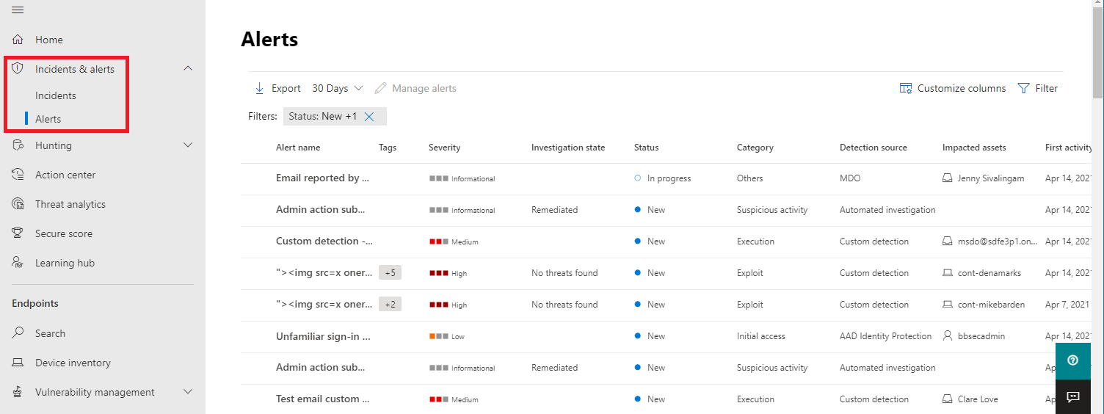
Manage and investigate alerts
You can update Incident management information, view all related information, or jump to investigation pages for the associated data.
Notes:
You can use the Attack simulators to generate Incidents for demonstration purposes
Supporting videos for instructor or student use:
Microsoft Defender for Endpoint: Using the new alert experience
https://www.microsoft.com/en-us/videoplayer/embed/RE4yiO5?rel=0&postJsllMsg=true
(3 minutes)

Slide 14
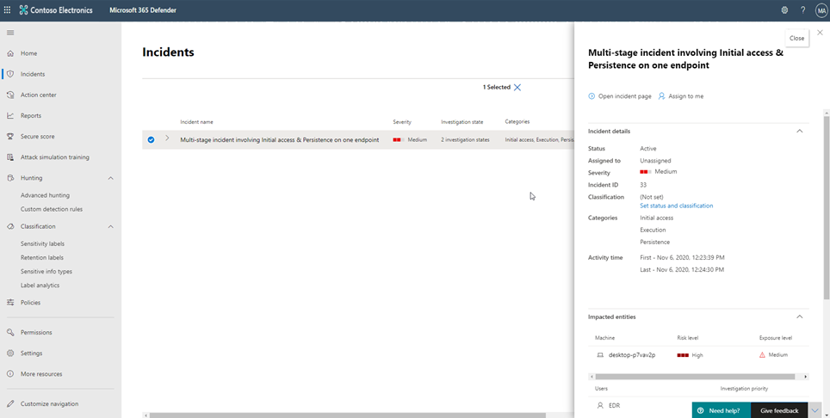
Investigate incidents
Microsoft 365 Defender provides a cross domain threat correlation and purpose-driven portal to investigate incidents.

Slide 15
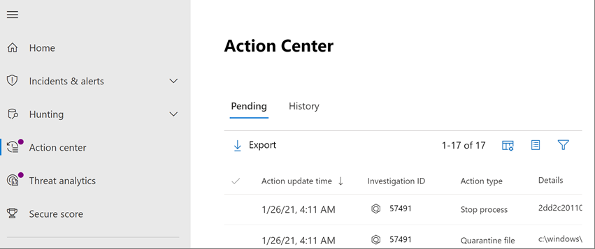
Use the Action Center
The action center consists of two main tabs: Pending actions and History.
Notes:
You can use the Attack simulators to generate Incidents for demonstration purposes

Slide 16
Perform advanced hunting
Advanced hunting is a query-based threat-hunting tool that lets you explore up to 30 days of raw data. You can proactively inspect events in your network to locate threat indicators and entities. The flexible access to data enables unconstrained hunting for both known and potential threats.
Perform root cause analysis
Create custom detections
Notes:
Supporting videos for instructor or student use:
Microsoft Defender for Endpoint: Advanced hunting
https://www.microsoft.com/en-us/videoplayer/embed/RE4bGqo?rel=0&postJsllMsg=true
(4:47 minutes)

Slide 17
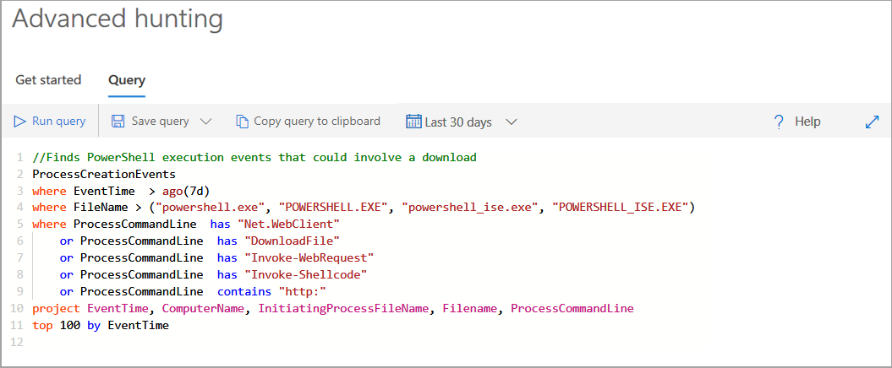
Hunt threats within your network
Advanced hunting within Microsoft Defender allows you to hunt for possible threats across your organization using a powerful search and query tool.
Notes:
Supporting videos for instructor or student use:
Video: Advanced Hunting Microsoft Defender
https://www.microsoft.com/en-us/videoplayer/embed/RE4COn3?postJsllMsg=true
(5 minutes)
Microsoft Defender for Endpoint: Advanced hunting
https://www.microsoft.com/en-us/videoplayer/embed/RE4bGqo?rel=0&postJsllMsg=true
(4:47 minutes)
Interactive Guide: Investigate and remediate threats with Microsoft Defender for Endpoint
https://aka.ms/MSDE-IG
(17 minutes)

Slide 18
Consult Microsoft threat experts
Microsoft Threat Experts is a managed threat hunting service that provides Security Operation Centers (SOCs) with expert level monitoring and analysis to ensure critical threats in their unique environments are not missed.
Targeted attack notification
Collaborate with experts, on demand
Notes:
Supporting videos for instructor or student use:
Microsoft Defender for Endpoint: Microsoft Threat Experts
https://www.microsoft.com/en-us/videoplayer/embed/RE4qZ0B?rel=0&postJsllMsg=true
(3:42 minutes)
Instructor demonstration:
Manage Incidents
Review an Alert
Review the Action Center

Slide 19
Lesson 3: Remediate risks with Microsoft Defender for Office 365

Slide 20
Lesson introduction
After this lesson, you will be able to:
Define the capabilities of Microsoft Defender for Office 365
Describe how to simulate attacks within your network
Explain how Microsoft Defender for Office 365 can remediate risks in your environment

Slide 21
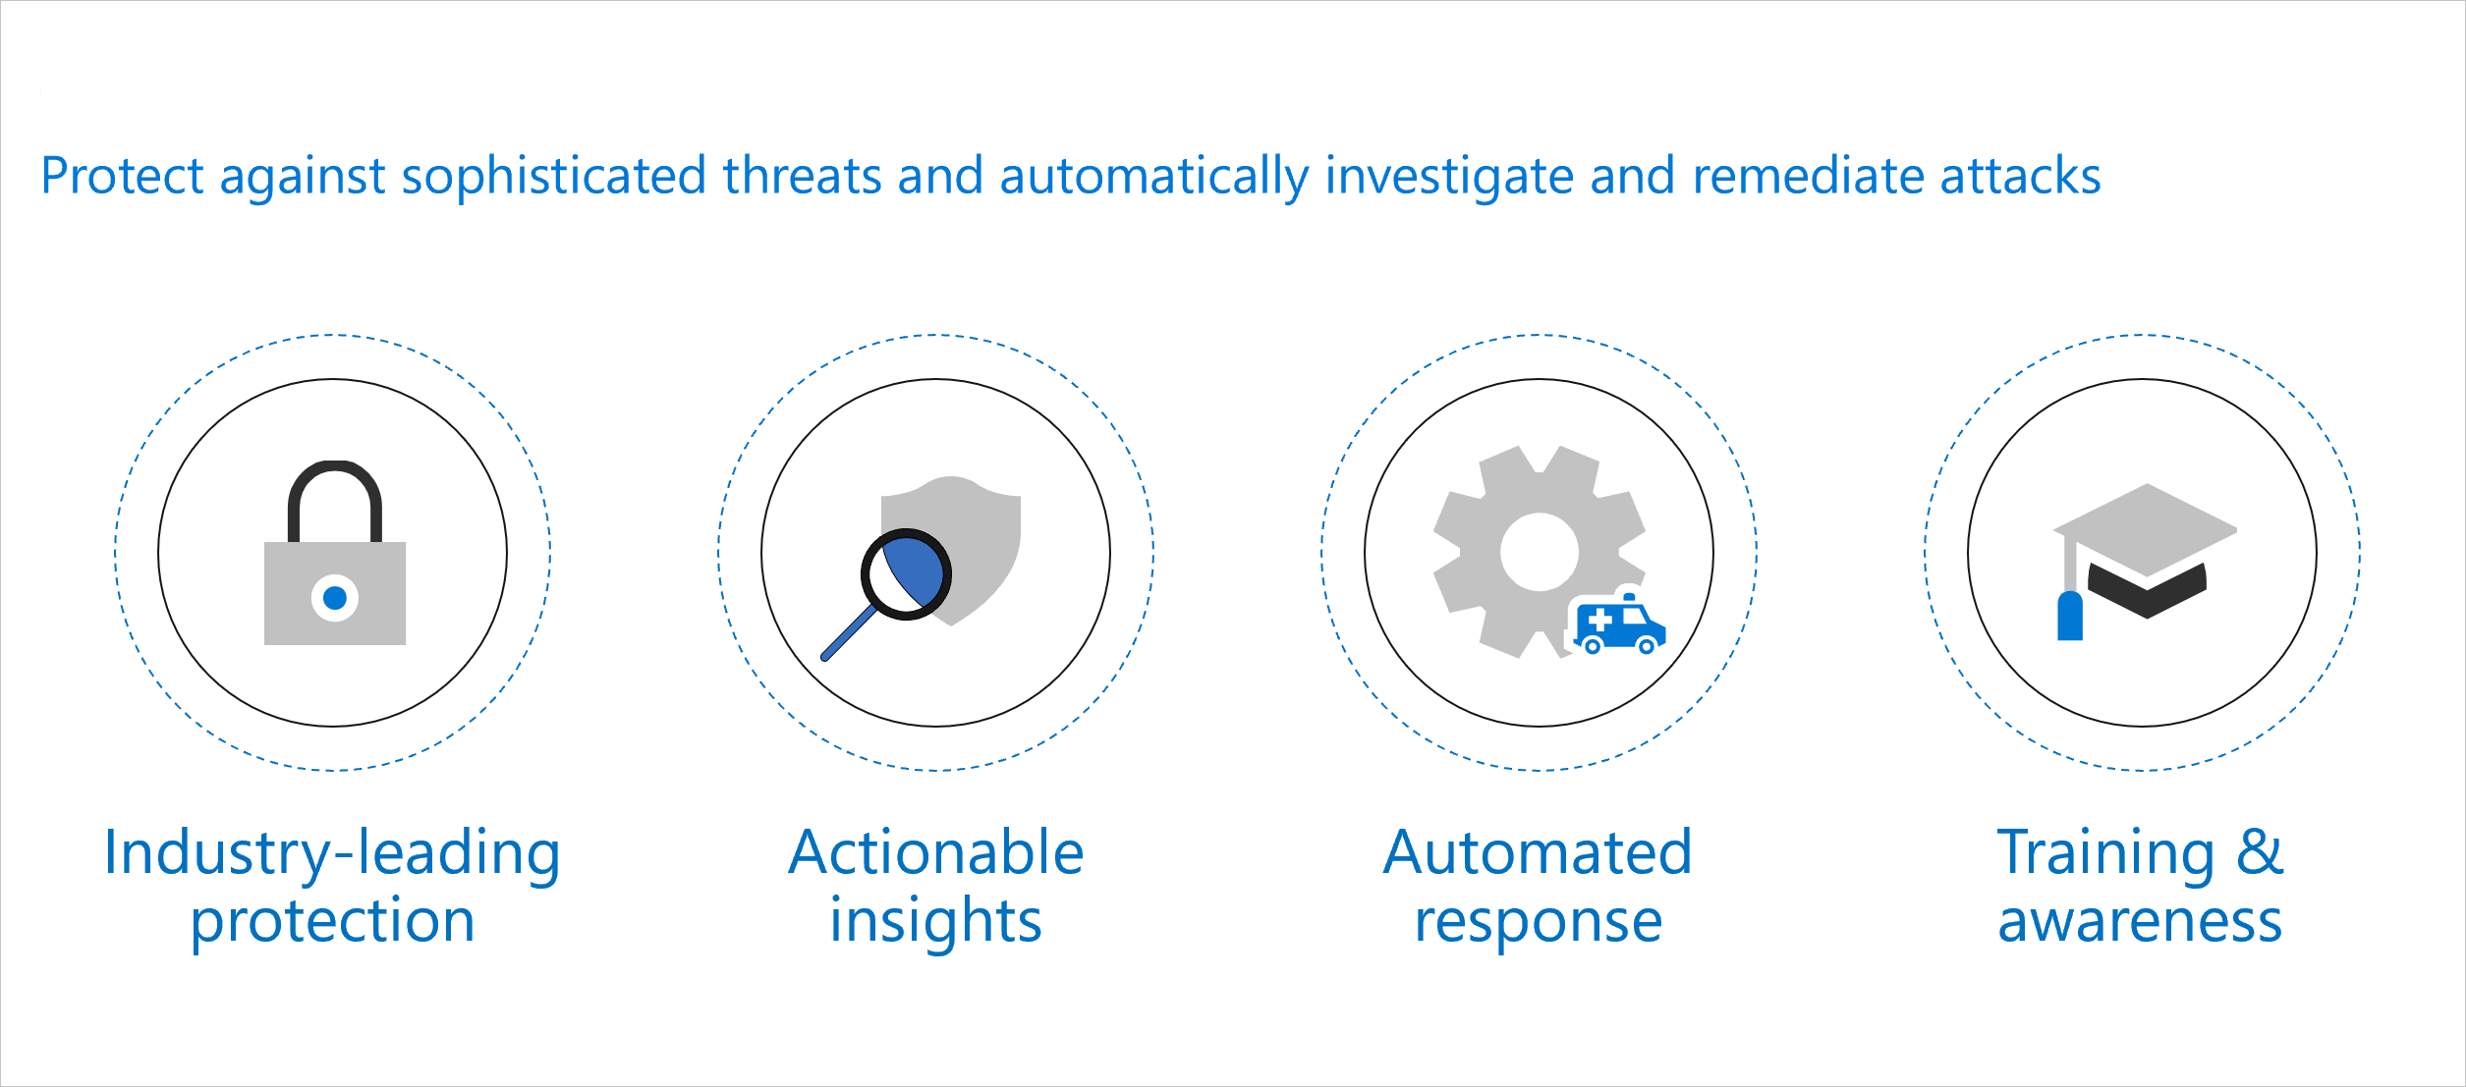
Microsoft Defender for Office 365 explained
Microsoft Defender for Office 365 is a cloud-based email filtering service that helps protect your organization against unknown malware and viruses by providing robust zero-day protection.

Slide 22
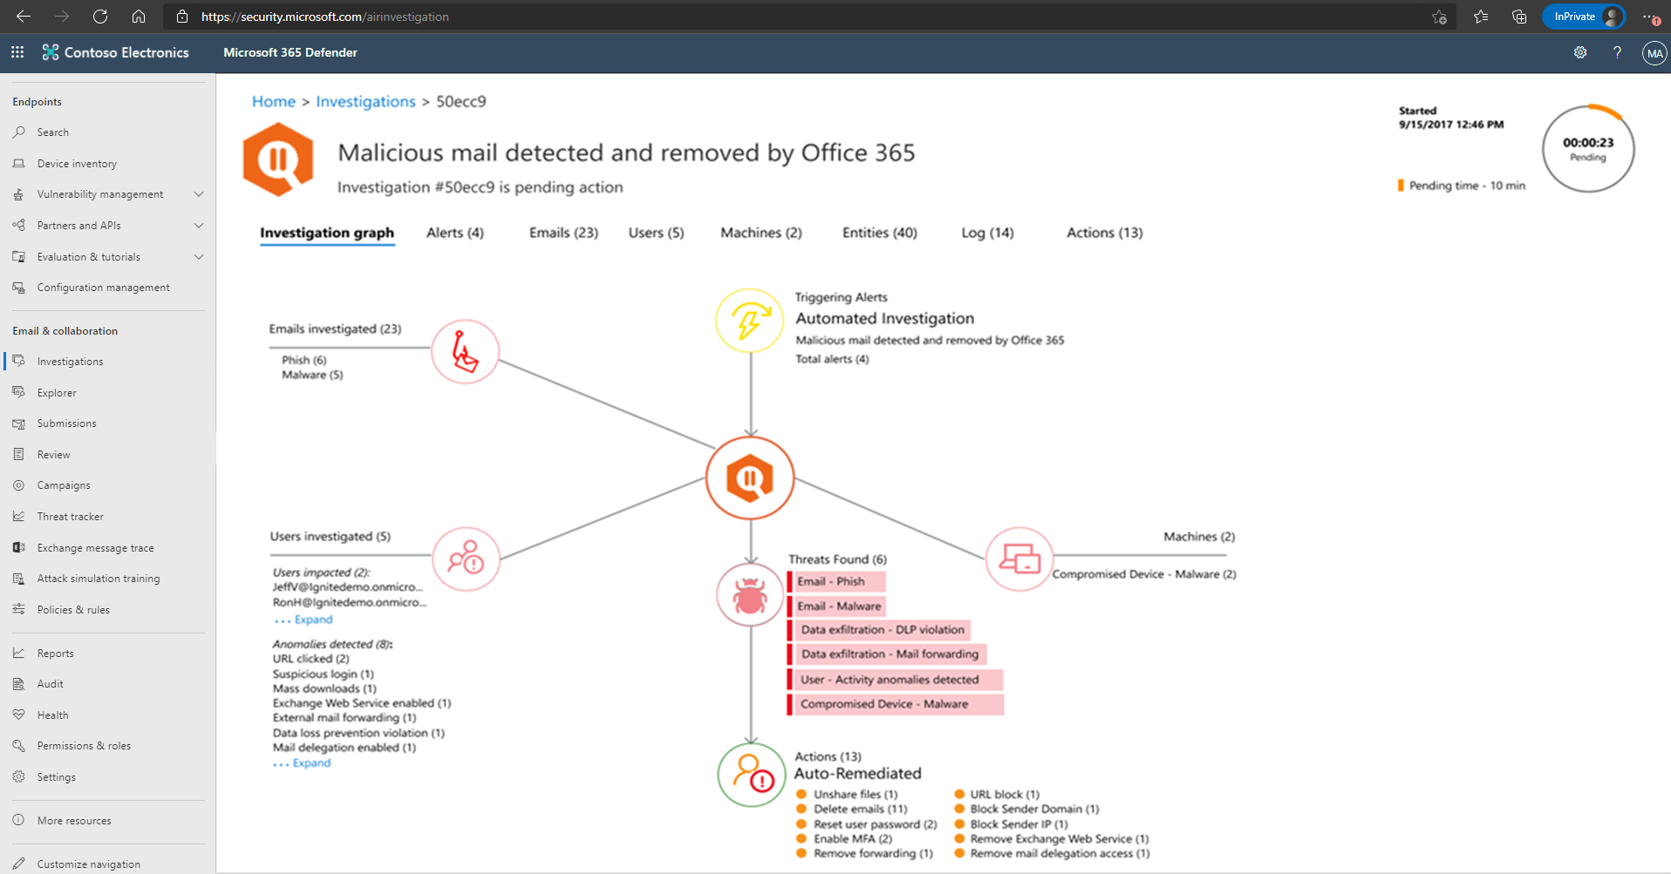
Automate, investigate, and remediate

Slide 23
Guided Demonstration – Defender for Office 365
Scenario:
You are the security operations analyst and must protect your Office 365 workloads in your organization.
Task 1
Configure policies
Task 2
Analyze threats
Task 3
Respond to attacks
Notes:
This recorded demo is provided to give learners a sense of Microsoft Defender for Office 365.
Follow the annotations and advice for where to click.
Time required: 28 minutes
Guided demo link: https://aka.ms/MSDO-IG

Slide 24
Simulate attacks
Threat trackers
Threat Explorer
Attack Simulator
Notes:
Instructor demonstration:
Create Environment
Device Onboarding
Device Groups
Add a Role

Slide 25
Lesson 4: Microsoft Defender for Identity

Slide 26
Lesson introduction
After this lesson, you will be able to:
Define the capabilities of Microsoft Defender for Identity
Describe how to configure Microsoft Defender for Identity sensors
Explain how Microsoft Defender for Identity can remediate risks in your environment

Slide 27
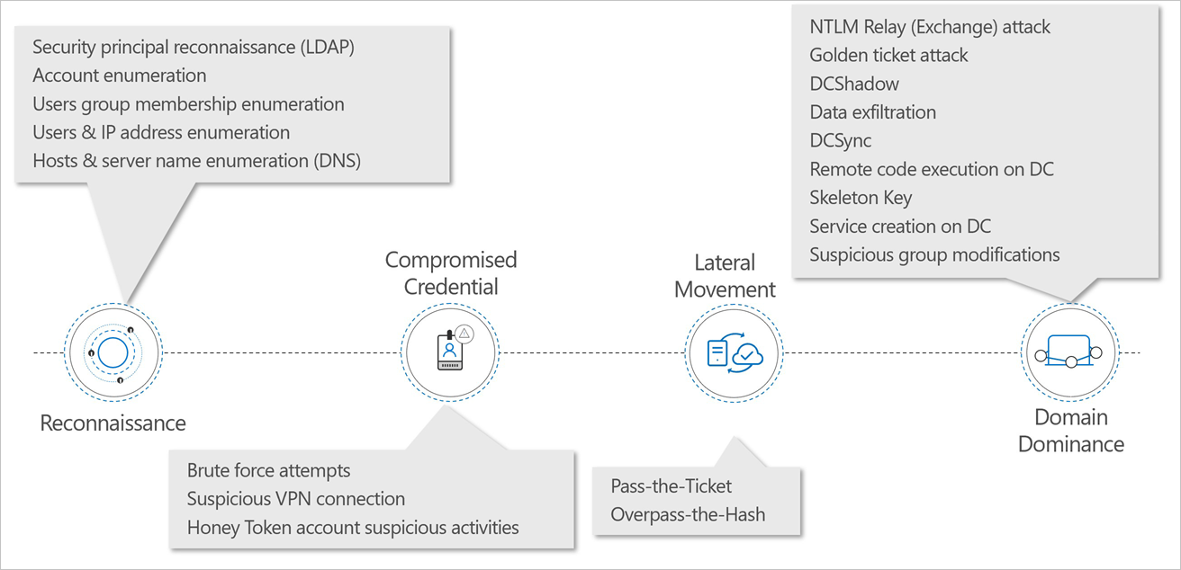
Microsoft Defender for Identity explained

Slide 28
Guided demonstration – Microsoft Defender for Identity
Scenario:
You are the security operations analyst and must protect your organization from identity attacks.
Task 1
Identify attacks
Task 2
Investigate behavior
Task 3
Reduce vulnerabilities
Notes:
This recorded demo is provided to give learners a sense of Microsoft Defender for Identity.
Follow the annotations and advice for where to click.
Time required: 30 minutes
Guided demo link: https://aka.ms/MSDefenderforIdentity-IG

Slide 29
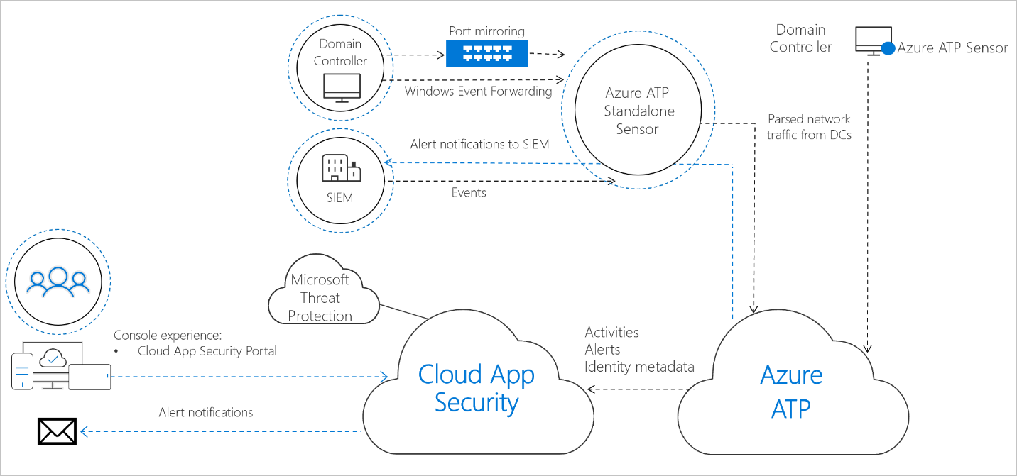
Configure Microsoft Defender for Identity sensors
Notes:
Supporting videos for instructor or student use:
Interactive guide: Investigate and respond to attacks with Microsoft Defender for Identity
https://mslearn.cloudguides.com/guides/Investigate%20and%20respond%20to%20attacks%20with%20Microsoft%20Defender%20for%20Identity
(14 minutes)

Slide 30
Lesson 5: Azure AD Identity Protection

Slide 31
Lesson introduction
After this lesson, you will be able to:
Describe the features of Azure Active Directory Identity Protection
Describe the investigation and remediation features of Azure Active Directory Identity Protection

Slide 32
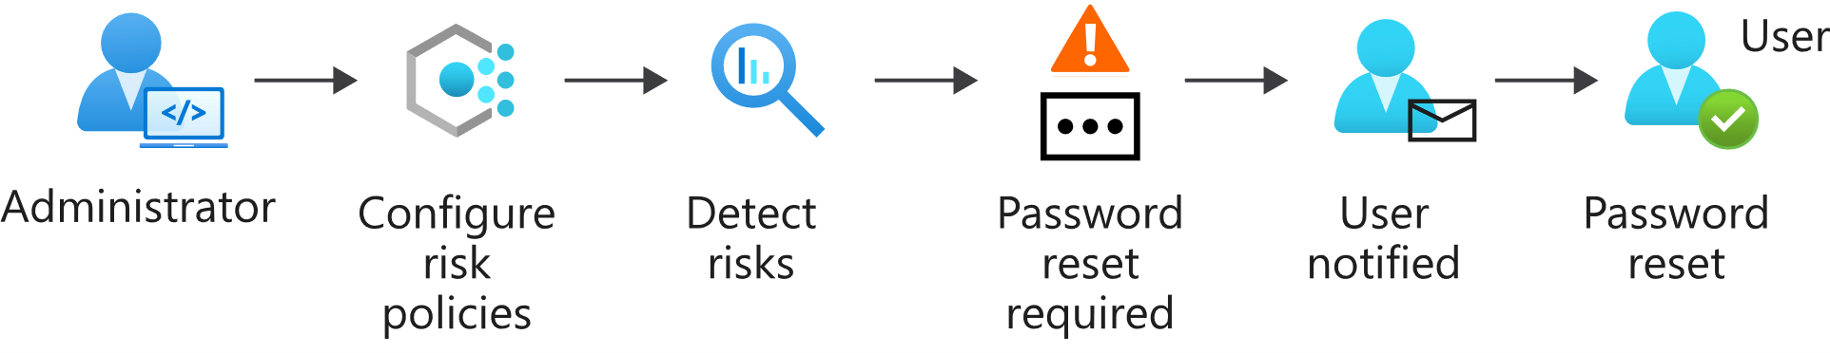
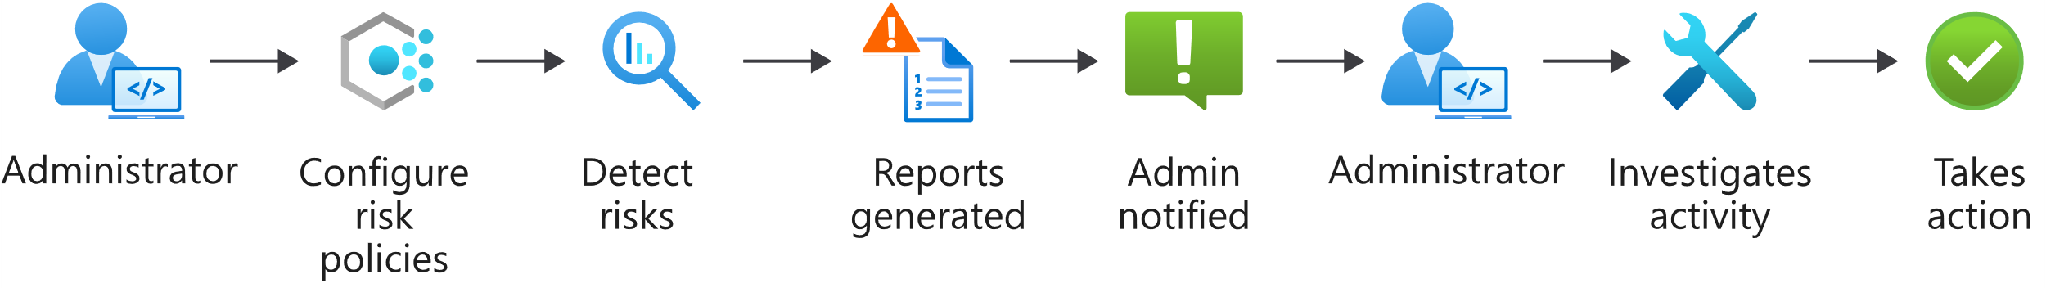
Azure AD Identity Protection explained
Self-remediation workflow
Administrator remediation workflow

Slide 33
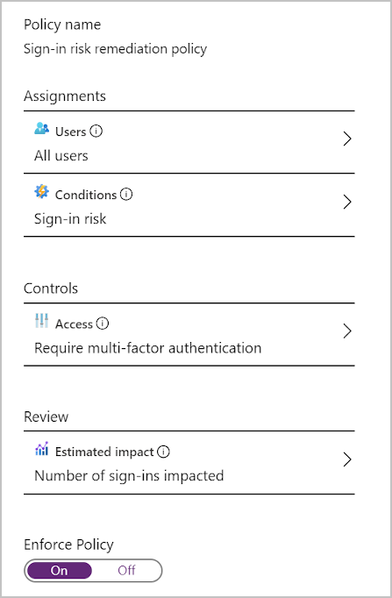
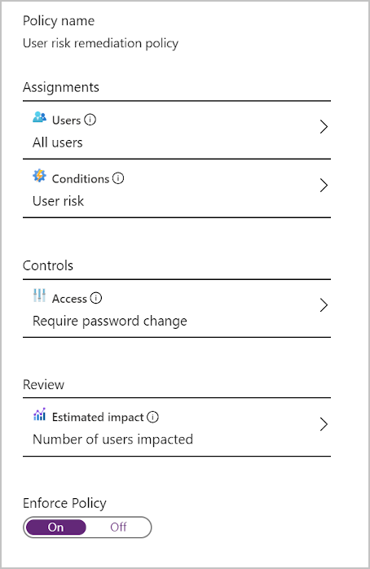
Detect risks with Azure AD Identity Protection policies
Sign-in risk policy
User risk policy

Slide 34
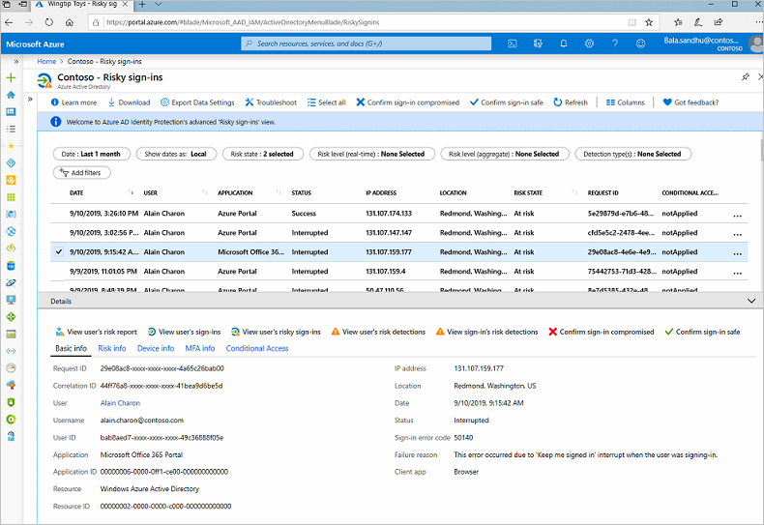
Remediate risks detected by Azure AD Identity Protection
Notes:
Instructor demonstration:
- Azure AD Identity Protection

Slide 35
Lesson 6: Microsoft Cloud App Security

Slide 36
Lesson introduction
After this lesson, you will be able to:
Define the Cloud App Security framework
Explain how Cloud Discovery helps you see what's going on in your organization
Describe how to use Conditional Access App Control policies to control access to the apps in your organization

Slide 37
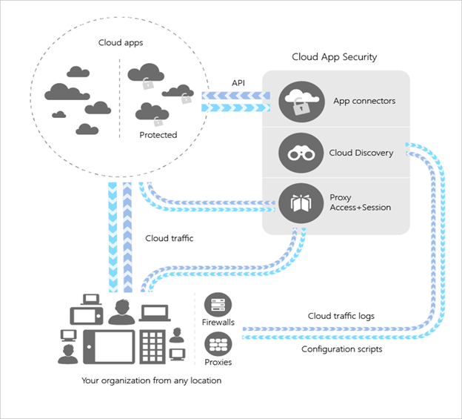
The Cloud App Security Framework
Discover and control the use of Shadow IT
Protect your sensitive information
anywhere in the cloud
Protect against cyberthreats and anomalies
Assess the compliance of your cloud apps

Slide 38
Explore your cloud apps with Cloud Discovery
Start at the Cloud Discovery dashboard then move through its elements in the following order to understand what's happening in your organization.
Start with the High-level usage overview to see the overall cloud app use.
Dive one level deeper to see which category of apps your organization uses most in Sanctioned apps.
Go even deeper on the Discovered apps tab. See all the apps in a specific category.
Review the risk score for the discovered apps in the App risk overview.
View where discovered apps are located (based on their headquarters) in the App Headquarters map.
If you find an app that poses a risk to your organization, you can flag it as Unsanctioned in the Discovered apps pane.

Slide 39
Protect your data and apps with Conditional Access App Control
Prevent data exfiltration
Protect on download
Prevent upload of unlabeled files
Monitor user sessions for compliance
Block access
Block custom activities
Notes:
Resources for instructors to use at their discretion:
Microsoft Cloud App Security – comprehensive demo
https://www.microsoft.com/en-us/videoplayer/embed/RE4CMYG?postJsllMsg=true
Follow the annotations and blinking circle for where to click.
Time required: 26 minutes

Slide 40
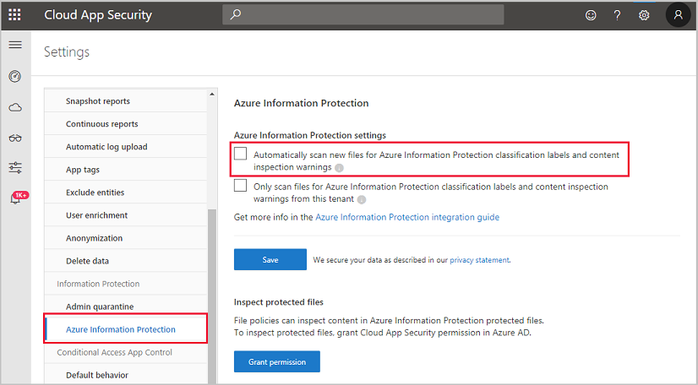
Classify and protect sensitive information
1
Discover data
2
Classify sensitive
information
3
Protect data
4
Monitor and report

Slide 41
Guided demonstration – Cloud App Security
Scenario:
You are the security operations analyst and want to protect cloud applications in your organization.
Task 1
Identify suspicious activities
Task 2
Investigate risks
Task 3
Take appropriate action
Notes:
This recorded demo is provided to give learners a sense of how Microsoft Cloud App Security identifies and investigates risks.
Follow the annotations and advice for where to click.
Time required: 11 minutes
Guided demo link: https://aka.ms/DetectThreats-ManageAlerts-MCAS_InteractiveGuide

Slide 42
Lesson 7: Respond to data loss prevention alerts

Slide 43
Lesson introduction
After this lesson, you will be able to:
Describe data loss prevention (DLP) components in Microsoft 365
Investigate DLP alerts in the Microsoft 365 compliance center
Investigate DLP alerts in Microsoft Cloud App Security

Slide 44
Describe data loss prevention alerts
With a DLP policy, you can: Data loss prevention components:
Identify sensitive information.
Sensitive information types
Prevent the accidental sharing of sensitive information.
Sensitivity labels
Monitor and protect sensitive information in the desktop versions of Excel, PowerPoint, and Word.
Data loss prevention policy
Help users learn how to stay compliant without interrupting their workflow.
Cloud App Security file policy
View DLP alerts and reports showing content that matches your organization’s DLP policies.

Slide 45
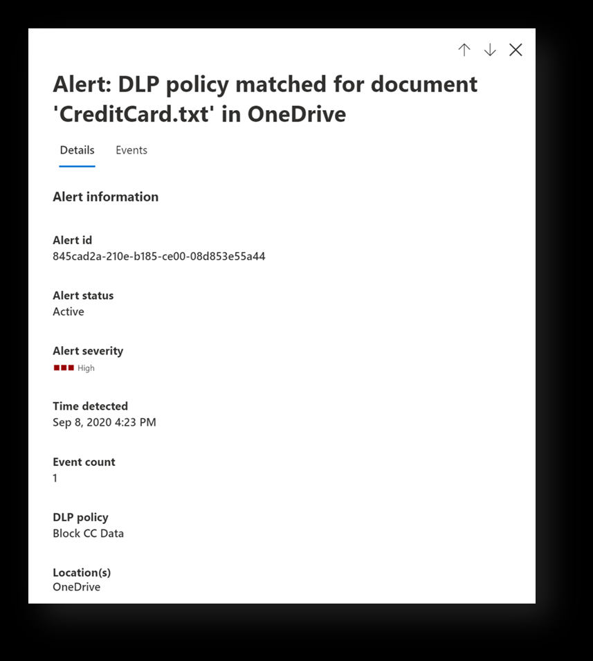
Investigate DLP alerts in Microsoft 365 compliance

Slide 46
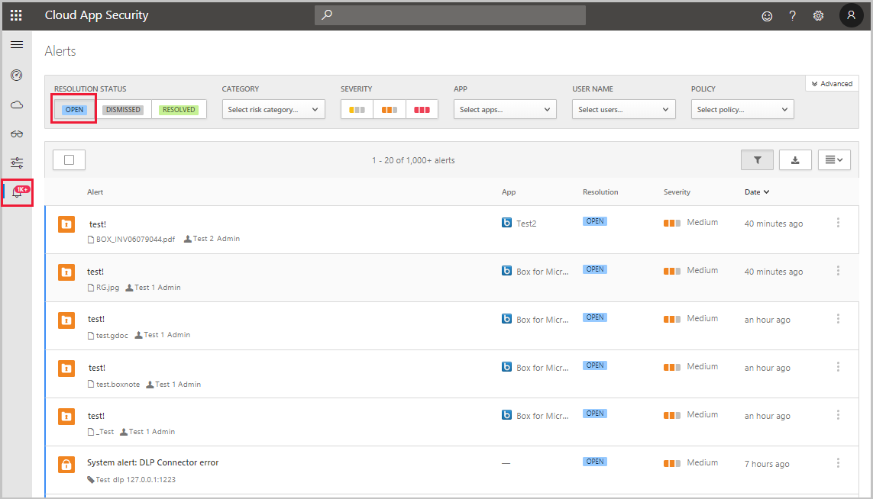
Investigate DLP alerts in Microsoft Cloud App Security
Notes:
Instructor demonstration:
DLP in Compliance admin center
DLP in Cloud App Security

Slide 47
Lesson 8: Manage insider risk in Microsoft 365

Slide 48
Lesson introduction
After this lesson, you will be able to:
Explain how insider risk management in Microsoft 365 can help prevent, detect, and contain internal risks in an organization
Describe the types of built-in, pre-defined policy templates
List the prerequisites that need to be met before creating insider risk policies
Explain the types of actions you can take on an insider risk management case

Slide 49
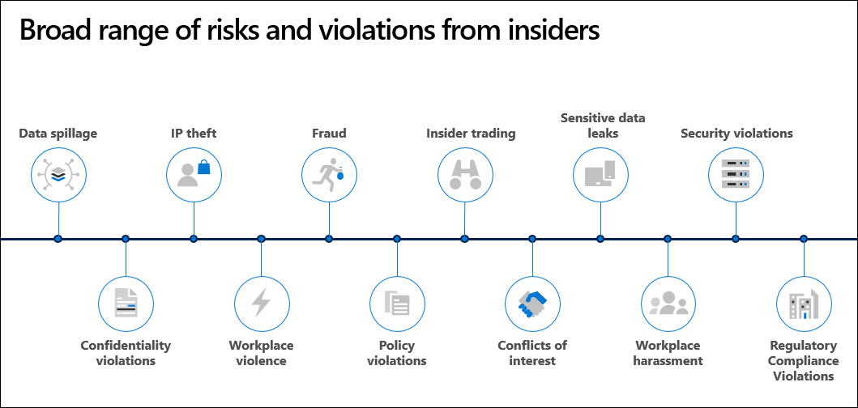
Insider risk management explained

Slide 50
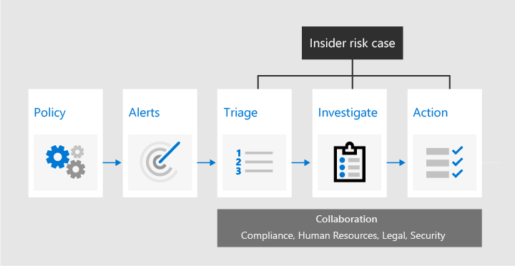
Insider risk management workflow
Notes:
Identifying and resolving internal risk activities and compliance issues with insider risk management in Microsoft 365 uses the workflow in this slide:

Slide 51
Manage insider risk policies
Policy templates
Policy settings
Departing employee data theft
Privacy and Indicators
Data leaks
Policy timeframes
Offensive language in email
Intelligent detections

Slide 52
Guided demonstration – Insider risk management
Scenario:
You are the security operations analyst and want to protect your organization from insider risks.
Task 1
Detect risky activities
Task 2
Investigate alerts
Task 3
Address potential threats
Notes:
This recorded demo is provided to give learners experience with Insider Risk Management.
Follow the annotations and advice for where to click.
Time required: 17 minutes
Guided demo link: https://mslearn.cloudguides.com/guides/Minimize%20internal%20risks%20with%20insider%20risk%20management%20in%20Microsoft%20365

Slide 53
Knowledge check
Check your knowledge with the module quiz in your course viewer

Slide 54
Lab 01 – Mitigate threats using Microsoft 365 Defender

Slide 55
Lab Exercises
1
Explore Microsoft 365 Defender

Slide 56
Closing slide

